Slide 1





Part V – Building LLM-based web applications
Quang Duong

Slide 2
What we will obtain
Task-specific AI assistants
Simple AI chatbot
RAG (Retrieval Augmented Generation) + AI chatbots
Agent + AI chatbots

Slide 3
Backend with LangChain
Basic LLM-based QA engine
Prompt engineering
Parameterize prompts using user inputs
Document processing as retrievers
Integrate external tools to build AI agents

Slide 4
Basic LLM-based QA engine
Load requirement packages
Load environment variables
Initialize the chat model
Define prompt
Initialize memory
Define chain
Write QA function
QA

Slide 5
Basic LLM-based QA engine
1. Load packages
2. Load env variable
3. Initialize chat model
7. Write QA function
8. QA
4. Define prompt
5. Initialize memory
6. Define chain

Slide 6
Task-specific AI Assistant Apps
Culinary AI assistant
Marketing AI assistant
Customer AI assistant
Travel AI assistant
Summarization AI assistant
SQL-querying AI assistant
Job interview AI assistant
…

Slide 7
Task-specific AI Assistant Apps
# Load the environment variables
load_dotenv()
# Initialize the chat model, i.e. gpt-3.5-turbo
llm = ChatOpenAI(model_name="gpt-3.5-turbo", temperature=0)
# Define the prompt template
prompt_template = """
You are an XXX assistant.
Following is the scenario that you need to respond to:
{request}
"""
# Create a prompt
prompt = PromptTemplate(
input_variables=["request"],
template=prompt_template)
# Create LLM chain
chain = prompt | llm | StrOutputParser()
# Get response
response = chain.invoke({"request":prompt})

Slide 8
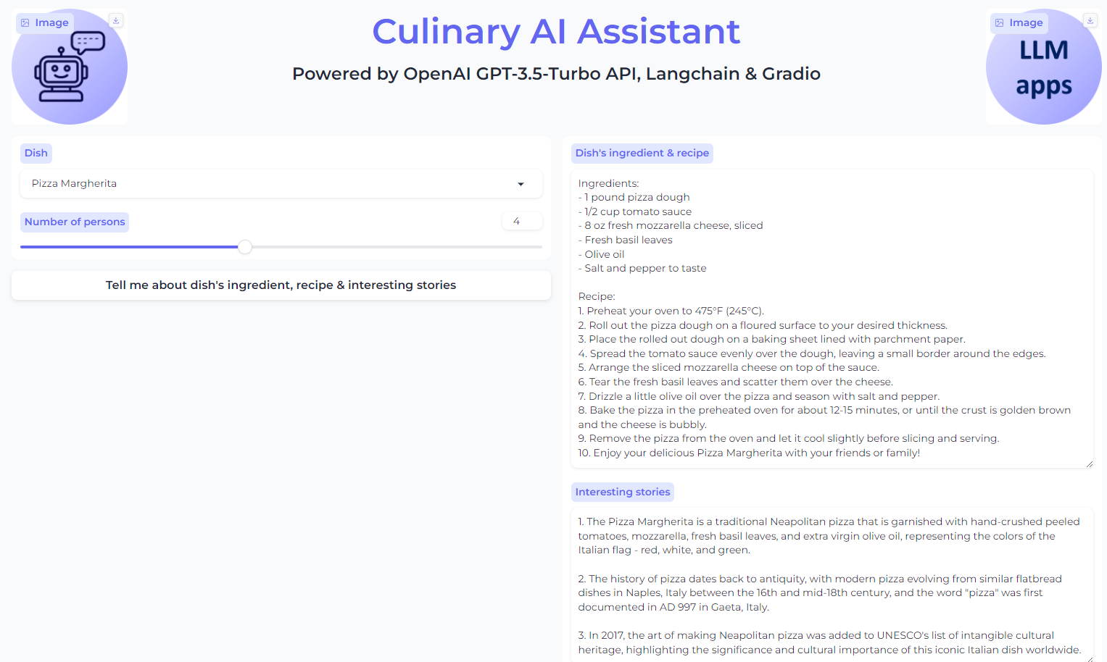
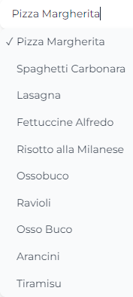
Culinary AI Assistant

Slide 9
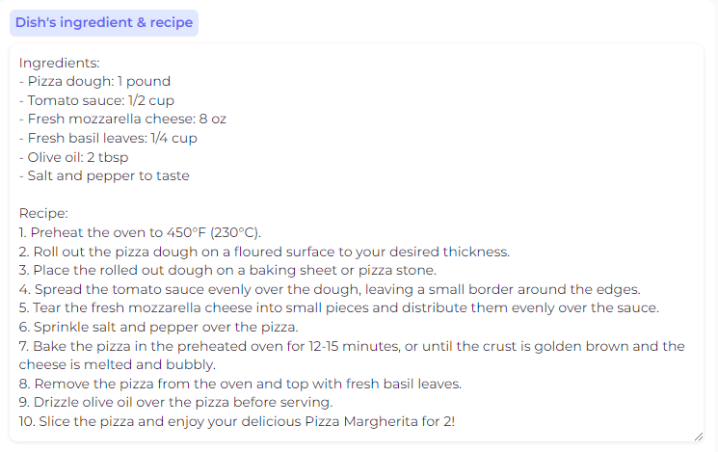
Parameterize prompt
recipe_prompt = f"""Present the recipe of {dish} for {no_per} persons. Return the response in 2 parts: Ingredients and Recipe.
For the Ingredients part, use the format as ingredient name : ingredient quantity.
For the Recipe part, make it clearly step by step."""
# Generate the recipe
recipe_response = chain.invoke({"request": recipe_prompt})

Slide 10
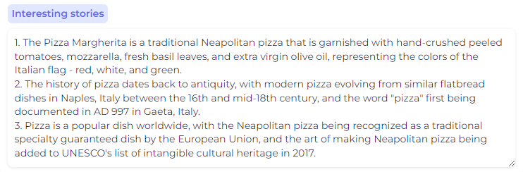
Search tool + parameterized prompt
# Define the prompt for the Wikipedia query
wiki_prompt = f"origin story of {dish}"
# Run the Wikipedia query with the defined prompt
wiki_result = wikipedia.run(wiki_prompt)
# Define the prompt for generating the story
food_story_prompt = f"""Present the 3 most interesting stories or facts about {dish}, one sentence for each, using this search data {wiki_result}"""
# Invoke the LLMChain with the story prompt to generate the story
food_story_response = chain.invoke(
{"request": food_story_prompt}
)

Slide 11
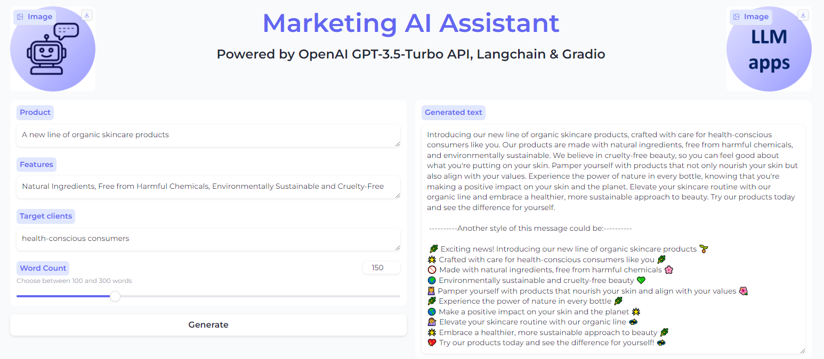
Marketing AI assistant

Slide 12
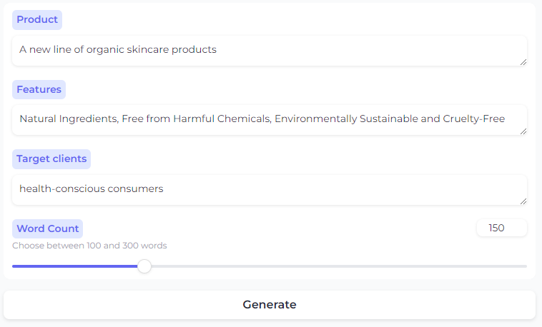
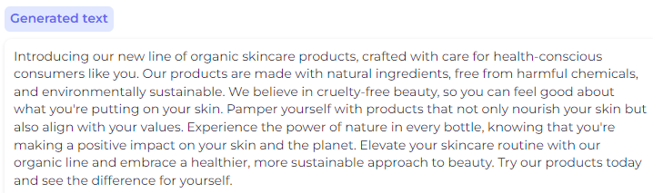
First request
request = f"""
Write a marketing message describing the product that is {product}, that has the features {features}.
The message is targeting towards {target_clients}.
The response should be no more than {word_limits} words.
"""
# Generate the marketing message
marketing_message = chain.invoke({"request": request_marketing})

Slide 13
Second request
# Request for new marking message
request_marketing_new_style = f"""
Use the following paragraph
Paragraph: {marketing_message}
Present it as another format with upbeat tone and emojis, main points in new lines.
"""
marketing_message_new_style = chain.invoke({"request": request_marketing_new_style})

Slide 14
Combining all responses
# Define the text to separate the original and new styles of the marketing message
text = "----------Another style of this message could be:----------"
# Combine the original and new styles of the marketing message into the final result
final_result = f"{marketing_message} \n\n {text}\n\n {marketing_message_new_style}"

Slide 15
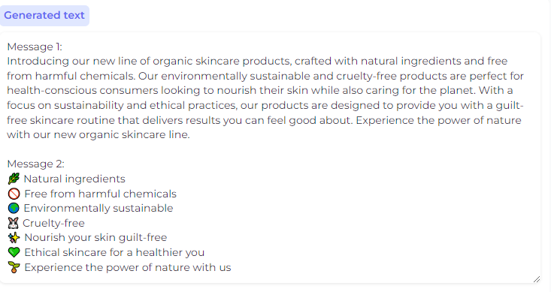
All-in-one prompt
request_marketing = f"""
Write two marketing messages describing the product that is {product}, that has the features {features}.
The message is targeting towards {target_clients}.
The first message should be as a paragraph in a professional tone, and the second message should be in main points in new lines with upbeat tone and emojis.
Each message should be no more than {word_limits} words.
"""

Slide 16
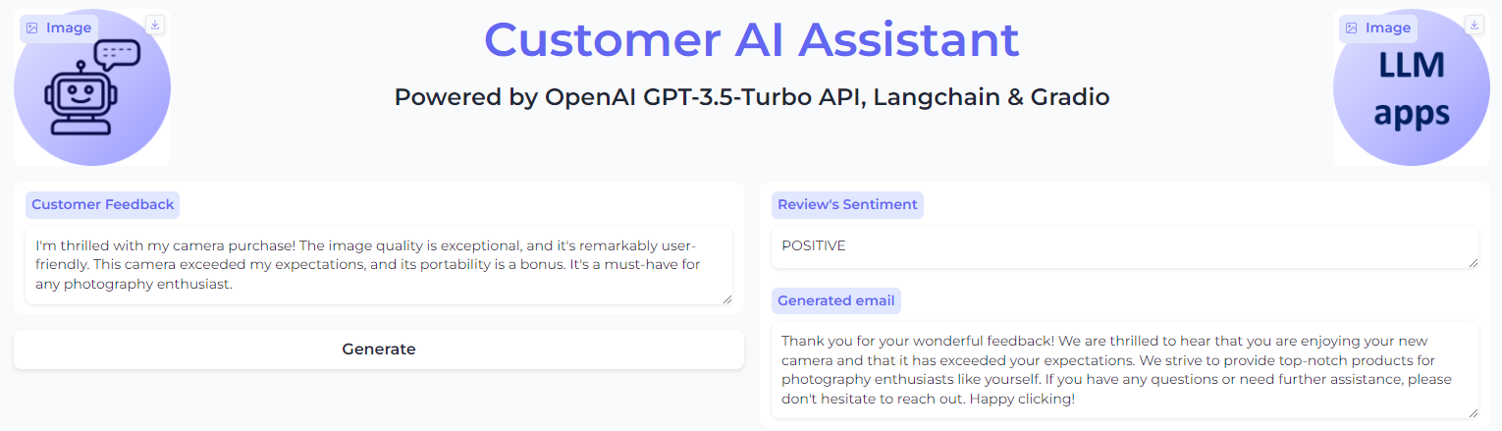
Customer AI Assistant

Slide 17
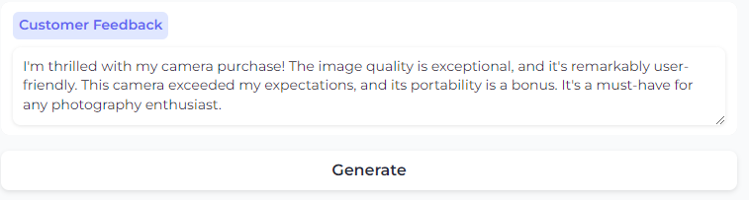
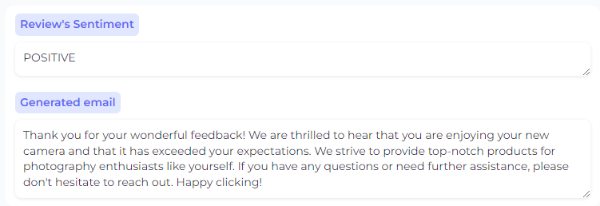
Customer AI Assistant
request = f"""
You received a client feedback: {client_feeback}. Determine the sentiment of the feedback and write an email to response to the client, no more than 100 words. The sentiment should be one of the following: POSITIVE, NEUTRAL, NEGATIVE.
Format the response as a JSON object with the following keys: 'sentiment' and 'response'.
"""
# Get response
response = chain.invoke({"request": request})
# Parse the response as a JSON object
response = json.loads(response)
# response["sentiment"]
# response["response"]

Slide 18
Simple AI Chatbot
Backend
LLMs:
Leveraging open-source LLMs via Hugging Face's ecosystem
Leverage LLM APIs, e.g. OpenAI API
LLM orchestrator: LangChain
Vector database: Faiss
Frontend
Gradio

Slide 19
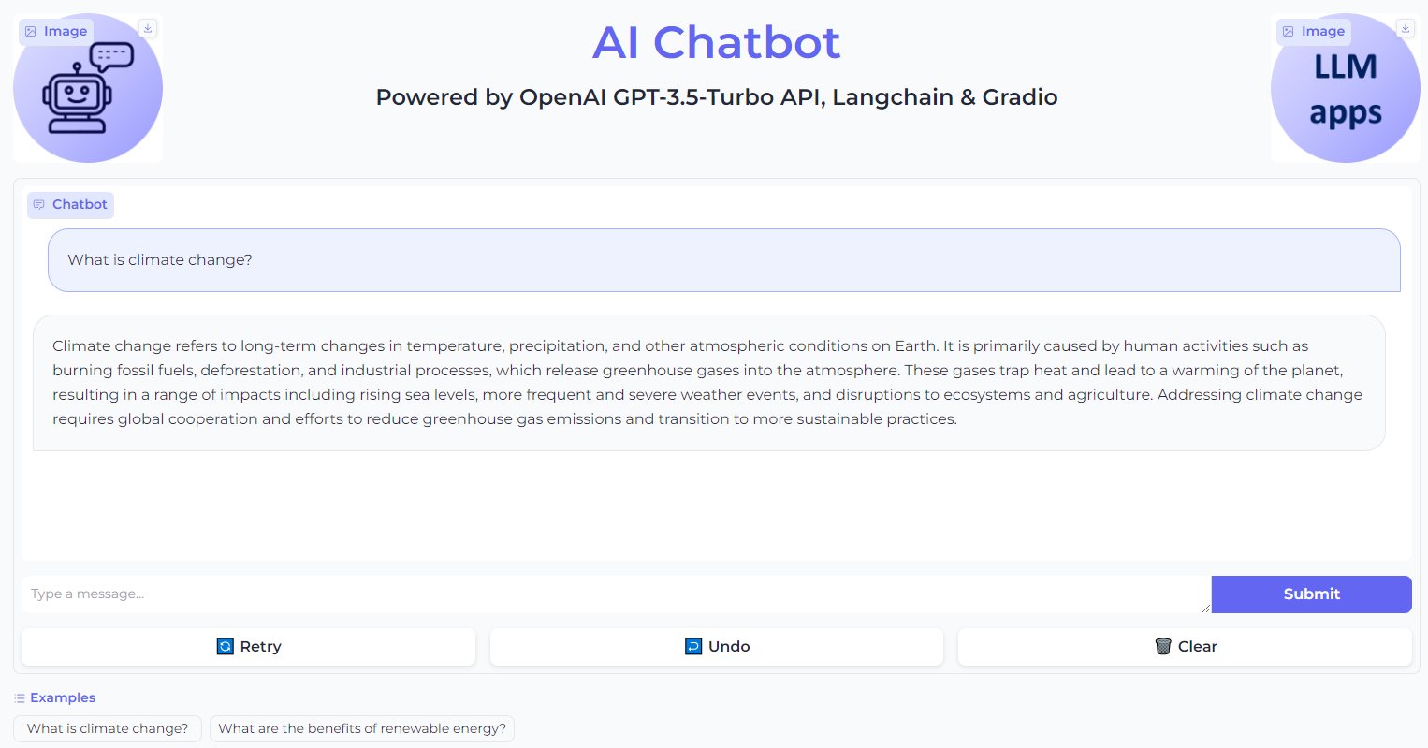
Simple AI Chabot demo

Slide 20
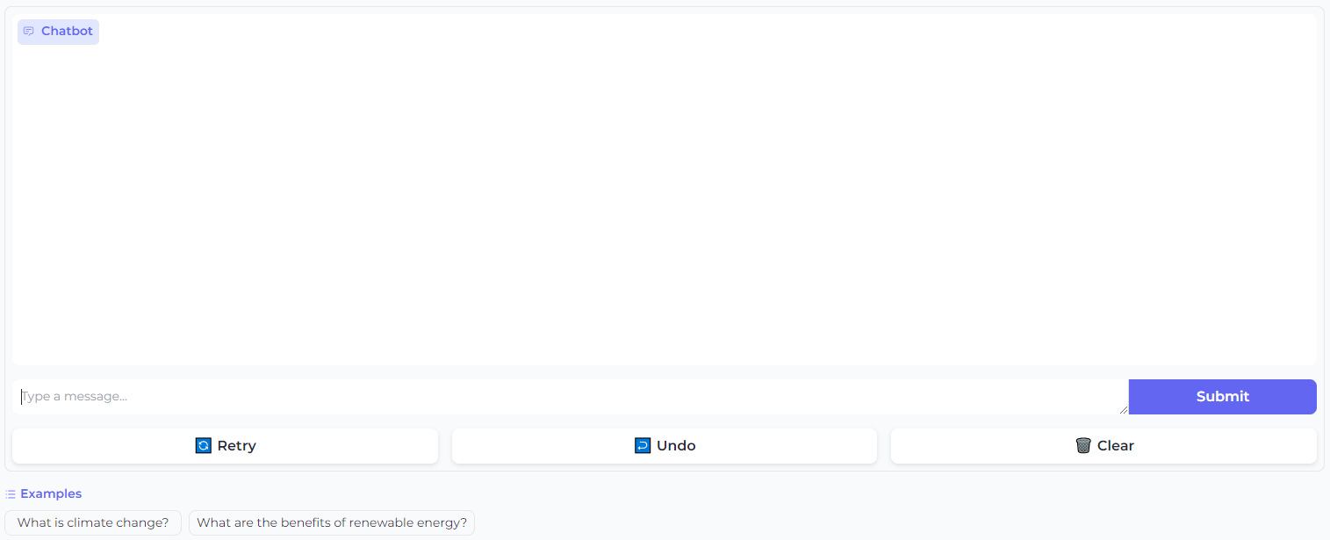
Chat Interface block
gr.ChatInterface(
predict,
examples=["What is climate change?", "What are the benefits of renewable energy?"],
)

Slide 21
No-memory AI Chabot demo
# Initialize the chat model, i.e. gpt-3.5-turbo
llm = ChatOpenAI(temperature=0, model_name="gpt-3.5-turbo")
# Define prompt template
prompt_template = '''
You are a helpful chatbot.
Return consistent and accurate answers for the following question.
Human: {question}
AI:
''' # Define prompt from template
prompt = ChatPromptTemplate.from_template(prompt_template)
# Define the chatbot chain
chain = prompt | llm | StrOutputParser()
# Define the inputs for the chatbot
inputs = {"question": question}
# Get the chatbot's response
llm_response = chain.invoke(inputs)

Slide 22
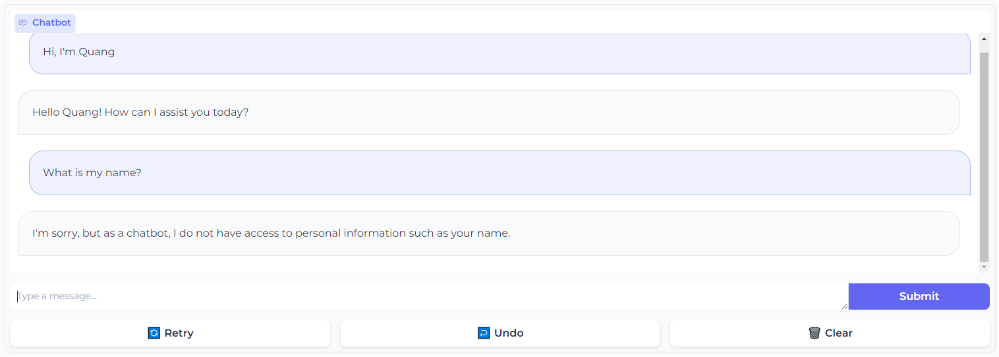
No-memory AI Chabot demo

Slide 23
With-memory AI Chabot demo
# Initialize the chat model, i.e. gpt-3.5-turbo
llm = ChatOpenAI(temperature=0, model_name="gpt-3.5-turbo")
# Define prompt template
prompt_template = '''
You are a helpful chatbot.
Here is the conversation history:
{history}
Return consistent and accurate answers for the following question.
Human: {question}
AI:
''' # Define prompt from template
prompt = ChatPromptTemplate.from_template(prompt_template)
# Initialize the conversation memory
memory = ConversationBufferMemory(return_messages=True)
# Define the chatbot chain
chain = RunnablePassthrough.assign(
history=RunnableLambda(memory.load_memory_va riables) | itemgetter("history"))
| prompt | llm | StrOutputParser()
# Define the inputs for the chatbot
inputs = {"question": question}
# Get the chatbot's response
llm_response = chain.invoke(inputs)
# Save the context for the next conversation turn
memory.save_context(inputs, {"output": llm_response})

Slide 24
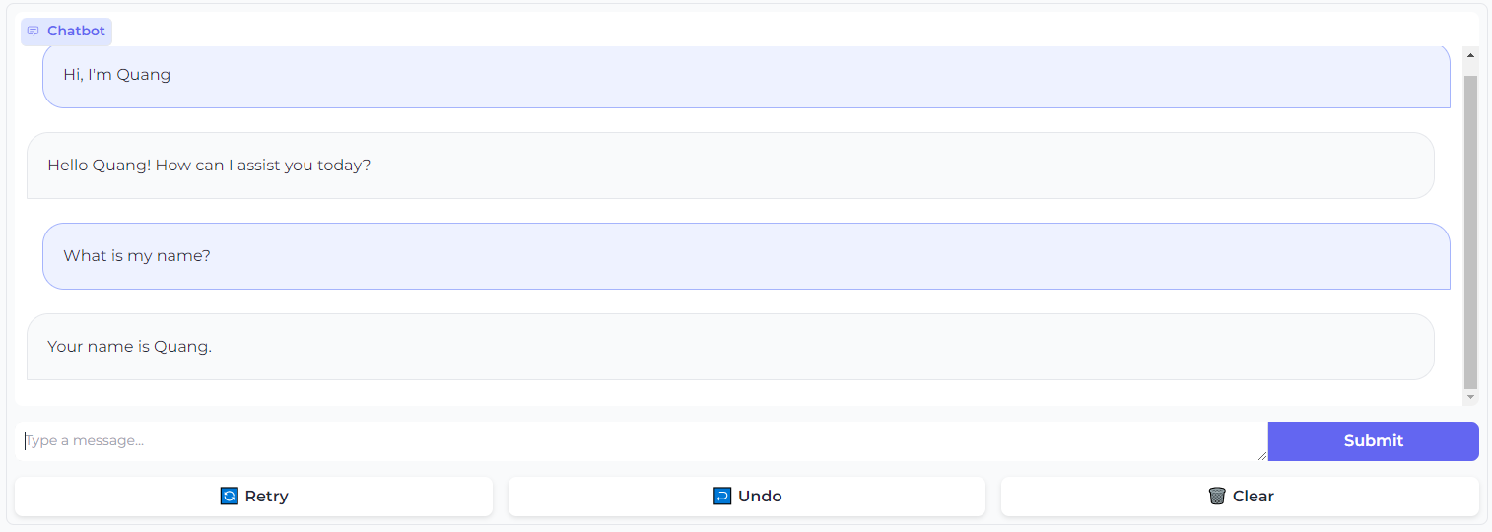
With-memory AI Chabot demo

Slide 25



AI Chatbot
Trained on published, non private data,
knowledge, e.g. until 2023
Answer
Question
LLMs
User
AI Chatbot

Slide 26
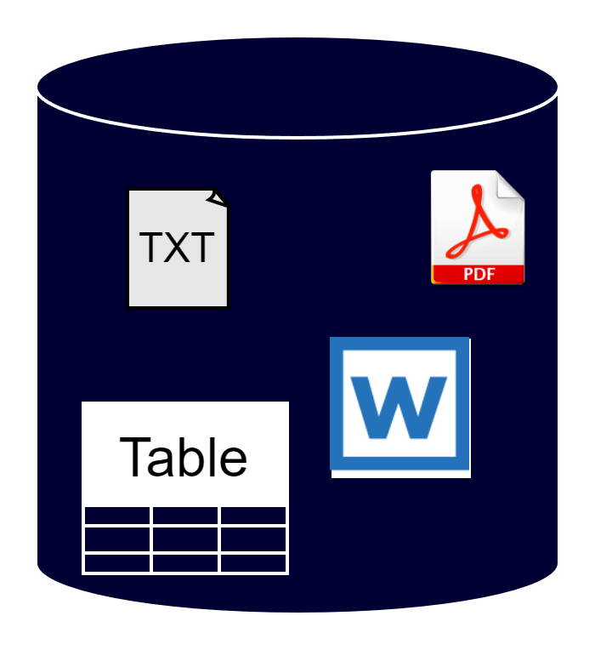
RAG + AI Chatbot
Trained on published, non private data,
knowledge, e.g. until 2023
Answer
Information retrieval
Question
LLMs
User
Recent data source, e.g. 2024
Private data source
AI Chatbot

Slide 27
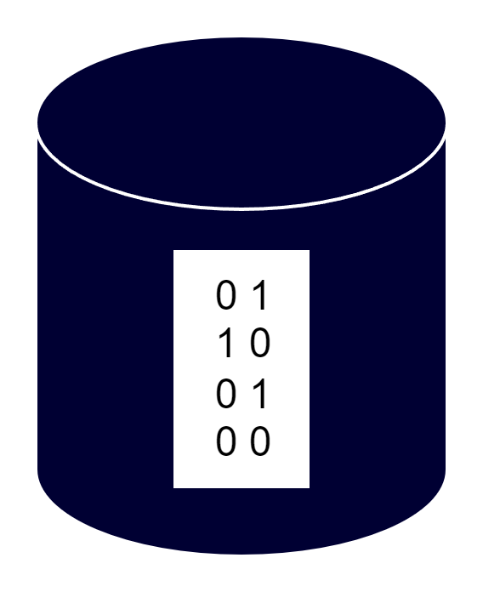
RAG (1/3) Generating vector database
Data loading
Vector Embedding
Vector database
Recent data source, e.g. 2024
Private data source

Slide 28
RAG (2/3) Information retrieval
User's question
Embedding
Vector database
Similarity search
Top-k retrieved information
(i.e. chunks of text)

Slide 29
RAG (3/3) Augmented generation
Trained on published, non private data,
knowledge, e.g. until 2023
Answer
Top-k retrieved information
(i.e. chunks of private text)
Question
LLMs
User
AI Chatbot

Slide 30
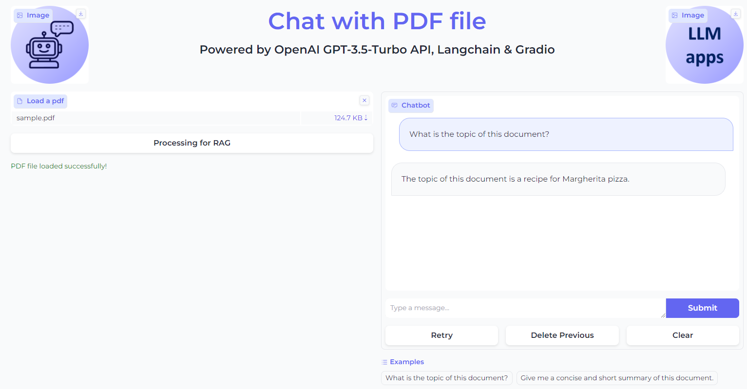
RAG + AI Chatbot demo

Slide 31
RAG + AI Chatbot
from langchain.chat_models import ChatOpenAI
from langchain.vectorstores.faiss import FAISS
from langchain.prompts import PromptTemplate
from langchain.text_splitter import CharacterTextSplitter
from langchain.schema.runnable import RunnablePassthrough
from langchain.document_loaders import PyPDFLoader
from langchain.embeddings import OpenAIEmbeddings
from langchain.schema import StrOutputParser
# Create chunks of text
loader = PyPDFLoader(file_path)
documents = loader.load()
text_splitter = CharacterTextSplitter(chunk_size=300, chunk_overlap=0)
texts = text_splitter.split_documents(documents)
# Create vector store vectorstore = FAISS.from_documents(documents=texts, embedding=OpenAIEmbeddings())
# Create retriever retriever = vectorstore.as_retriever(search_kwargs={"k": 1})

Slide 32
RAG + AI Chatbot
# Initialize the OpenAI model
llm = ChatOpenAI(model_name="gpt-3.5-turbo", temperature=0)
# Define the prompt template for the chatbot
prompt_template = """
You are an assistant for question-answering tasks. Use the following pieces of retrieved context to answer the question.
If you don't know the answer, just say that you don't know.
Question: {question}
Context: {context}
Answer:
"""
# Create the prompt template for the chatbot
prompt = PromptTemplate(
input_variables=["question", "context"],
template=prompt_template,
)
# Create the LangChain
rag_chain = (
{"context": retriever, "question": RunnablePassthrough()}
| prompt
| llm
| StrOutputParser()
)
def make_llm_response(question):
# Generate a response to the message
llm_response = rag_chain.invoke(question)
return llm_response
# Question example
question = "What is the topic of this document?"
make_llm_response(question)

Slide 33
AI Chatbot limitations
What's about daily knowledge?
How to do the math?
Trained on published, non private data,
knowledge, e.g. until 2023
Answer
Question
LLMs
User
AI Chatbot

Slide 34
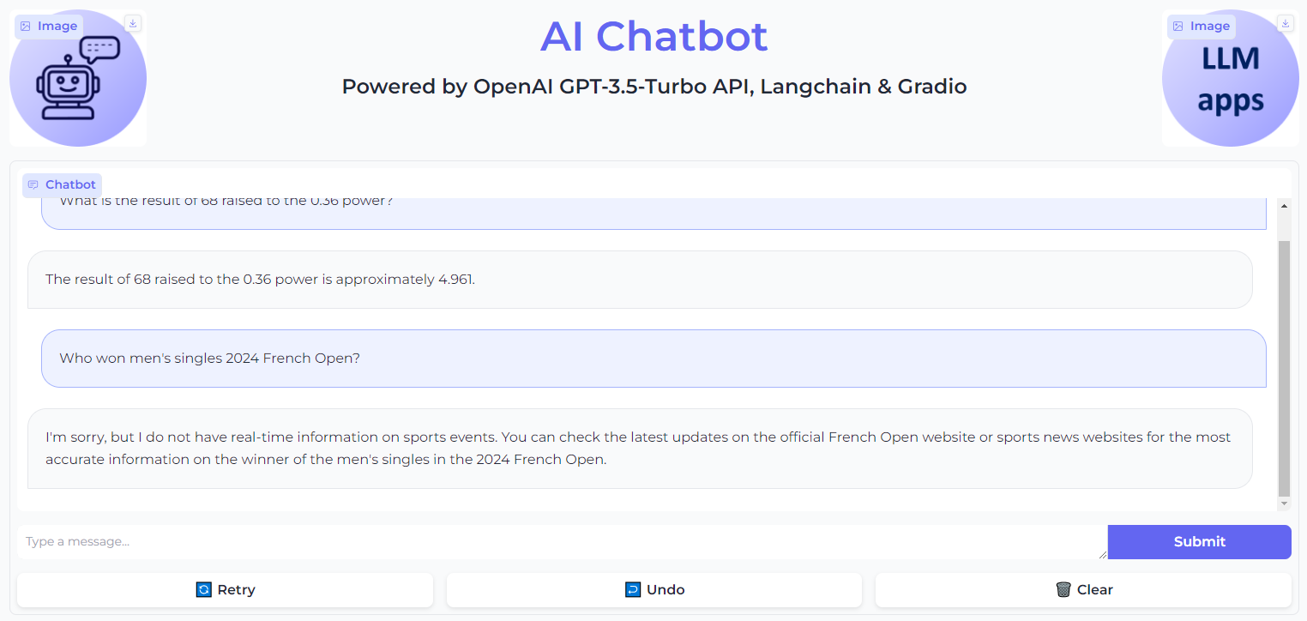
AI Chatbot limitations

Slide 35


Agent AI chatbot
Trained on published, non private data,
knowledge, e.g. until 2023
Response
Answer
Search tools
Query
Question
Math tools
LLMs
User
External tools
AI Chatbot

Slide 36
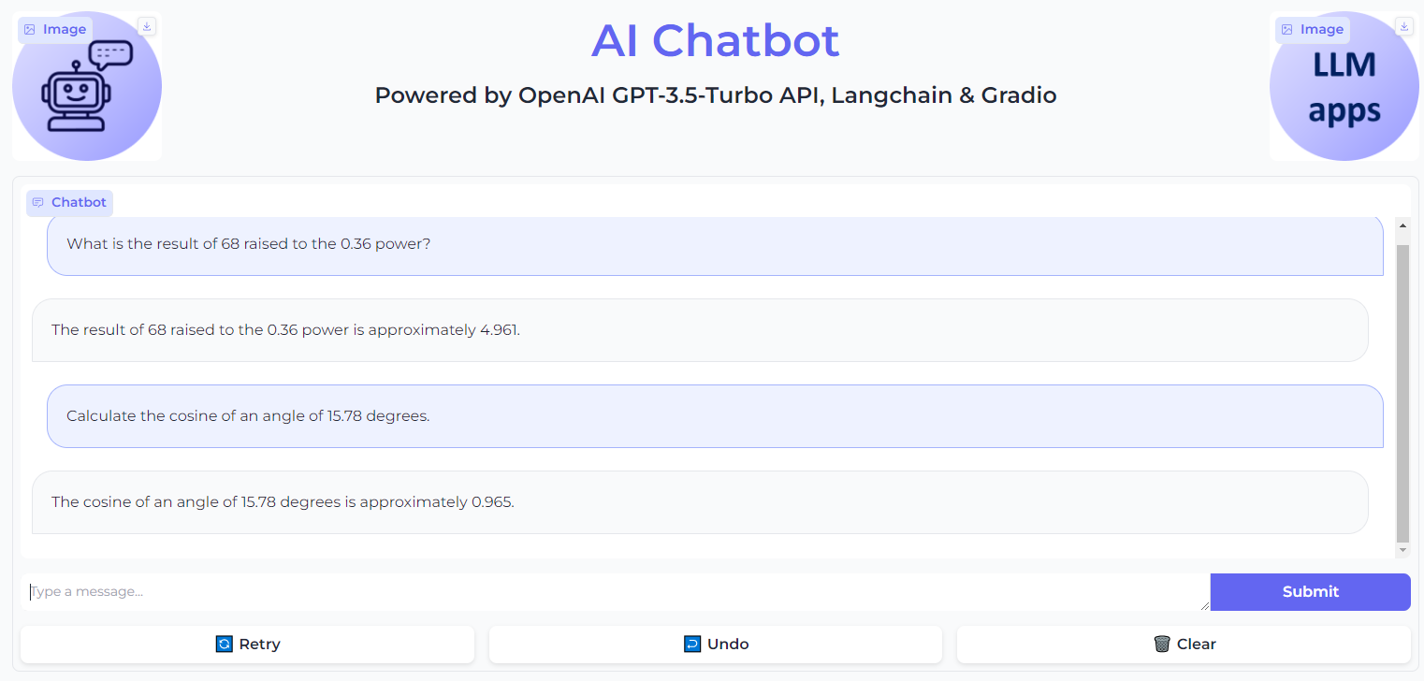
AI chatbot without Math tools

Slide 37
Agent AI chatbot with basic Math tool
def main():
global agent
load_dotenv()
# Initialize the language model
llm = ChatOpenAI(temperature=0, model_name="gpt-3.5-turbo")
conversational_memory = ConversationBufferMemory(
memory_key="chat_history",
return_messages=True,
)
llm_math = LLMMathChain(llm=llm)
# Initialize the math tool
math_tool = Tool.from_function(
name="Calculator",
func=llm_math.run,
description="Useful for when you need to answer questions about math.",
)
# Define the set of tools for the agent
tools = [math_tool]
# Initialize the agent with the set of tools, the language model, and the conversation buffer memory
agent = initialize_agent(
tools=tools,
agent="chat-conversational-react-description",
llm=llm,
verbose=True,
handle_parsing_errors=True,
early_stopping_method="generate",
memory=conversational_memory,
)
# Return the initialized agent
return agent

Slide 38
Agent AI chatbot with basic Math tool
def predict(message, history):
# Check if the agent is None
if agent is None:
# If the agent is None, call the main function to initialize the agent
main()
# Run the agent with the user's message to generate a response
agent_response = agent.run(message)
# Return the response from the chatbot
return agent_response

Slide 39
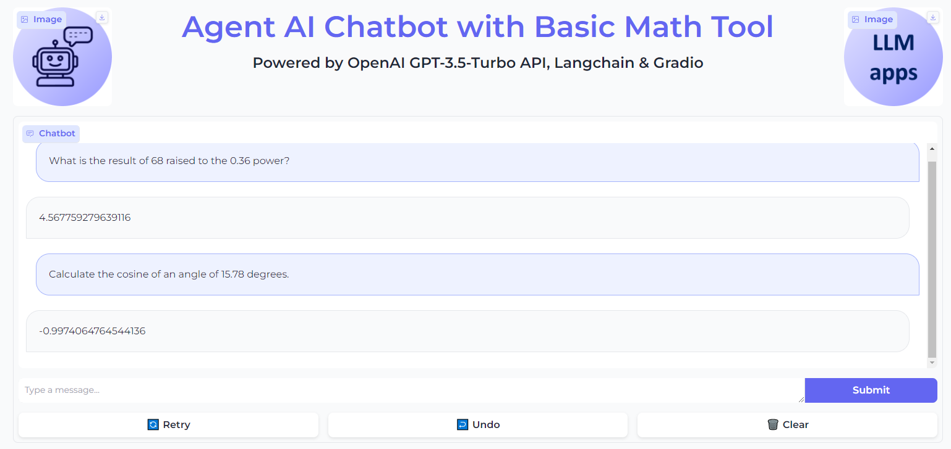
Agent AI chatbot with basic Math tool

Slide 40
Agent AI chatbot with Math tools +
class CosineDegreeTool(BaseTool):
name = "Cosine calculator"
description = "Use this tool when you need to calculate the cosine of an angle in degrees"
def _run(self, angle: Union[int, float]):
# Convert the angle from degrees to radians and calculate the cosine
return math.cos(math.radians(float(angle)))
def _arun(self, angle: int):
# Raise a NotImplementedError because this tool does not support async
raise NotImplementedError("This tool does not support async")
def main():
…
# Define the set of tools for the agent
tools = [math_tool, CosineDegreeTool()]
…

Slide 41
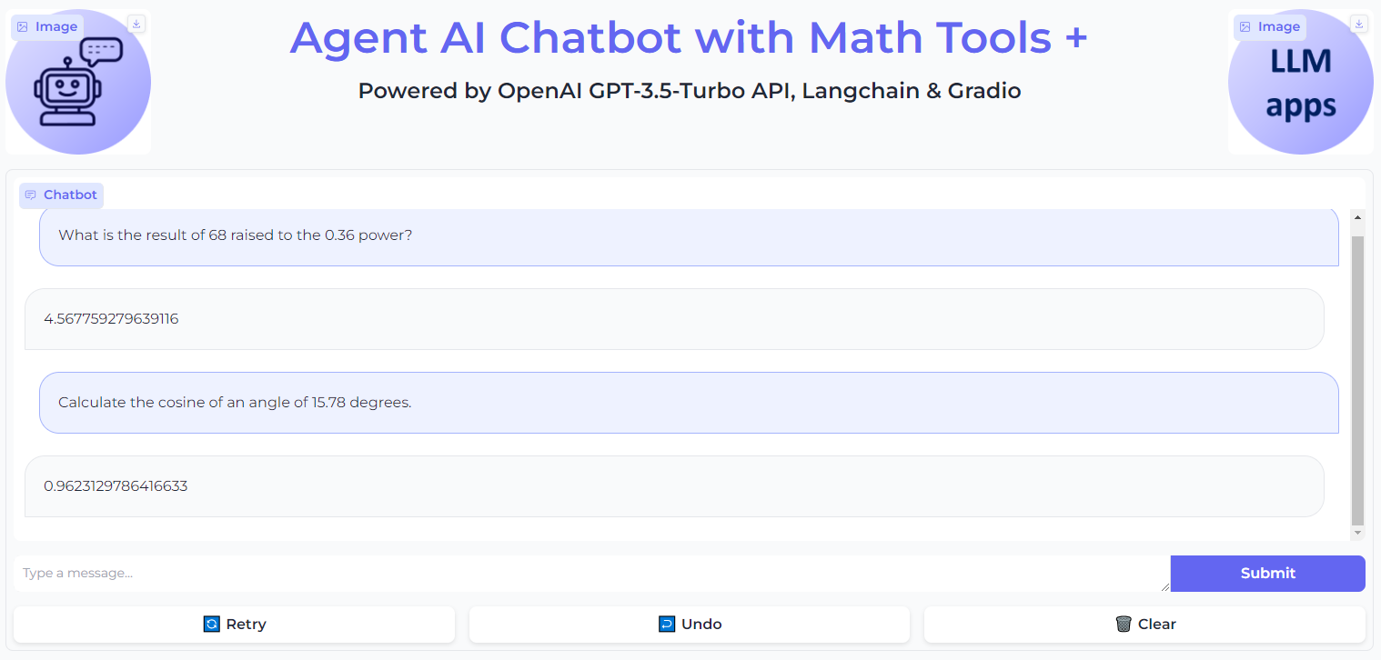
Agent AI chatbot with Math tools +

Slide 42
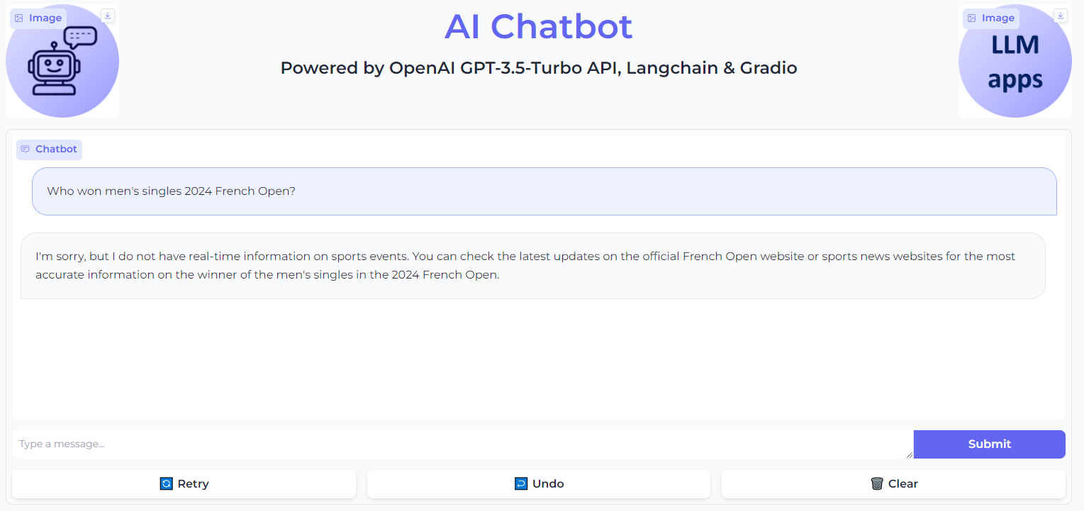
AI Chatbot without Search tool

Slide 43
AI Chatbot Agent with Search tools
def main():
global agent_executor
load_dotenv()
tools = [TavilySearchResults(max_results=1)]
chat = ChatOpenAI(model="gpt-3.5-turbo", temperature=0) prompt = ChatPromptTemplate.from_messages(
[(
"system",
"You are a helpful assistant. You may not need to use tools for every query - the user may just want to chat!",
),
MessagesPlaceholder(variable_name="messages"),
MessagesPlaceholder(variable_name="agent_scratchpad")
]) agent = create_openai_tools_agent(chat, tools, prompt) agent_executor = AgentExecutor(agent=agent, tools=tools, verbose=True) return agent_executor
def predict(message, history):
# Check if the agent variable is None
if agent_executor is None:
main()
agent_response = agent_executor.invoke(
{"messages": [HumanMessage(content=message)]})
# Return the response from the agent
return agent_response['output']

Slide 44
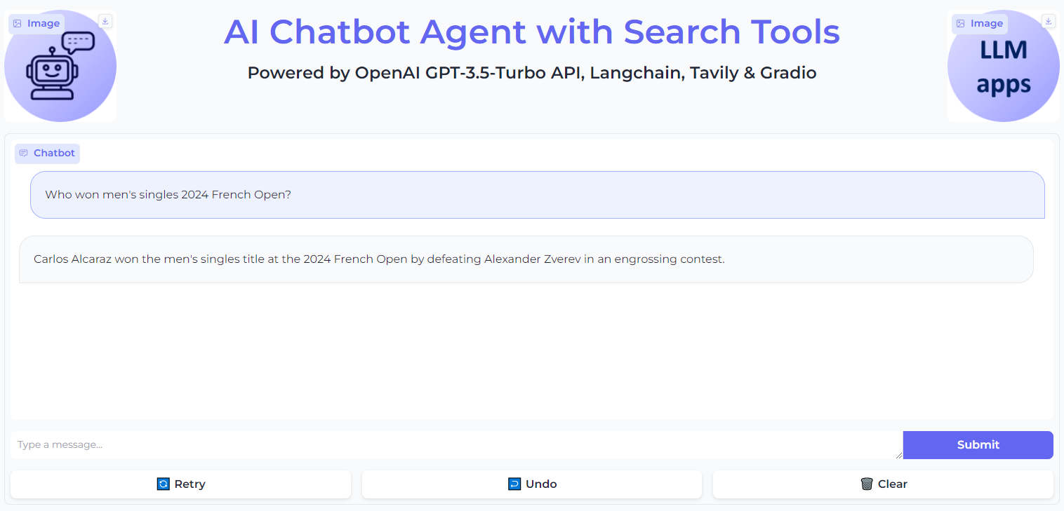
AI Chatbot Agent with Search tools

Slide 45
In summary
Built LLM-based web application demo
Backend
Python, LangChain, OpenAI API, FAISS, external tools: Wikipedia, Tavilty, etc.
Frontend
Python, Gradio
Learnt to build 4 types of LLM-based application
Task-specific AI assistants
AI chatbot
AI chatbot + Retrieval Augmented Generation (RAG) system
AI chatbot + Agent

